Slide 1
Middleware

Slide 2
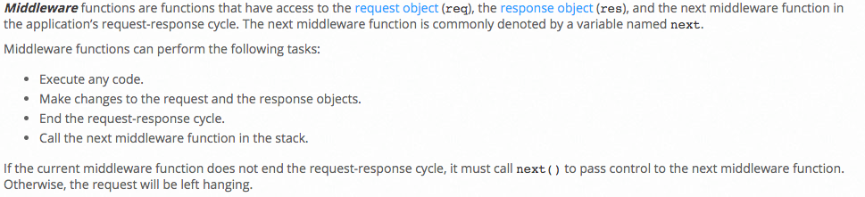
Middleware
“Middleware is computer software that provides services to software applications beyond those available from the operating system. It can be described as "software glue".^{[1]}
Middleware makes it easier for software developers to implement communication and input/output, so they can focus on the specific purpose of their application.” (Wikipedia)

Slide 3
Middleware
“Middleware is computer software that provides services to software applications beyond those available from the operating system. It can be described as "software glue".^{[1]}
Middleware makes it easier for software developers to implement communication and input/output, so they can focus on the specific purpose of their application.” (Wikipedia)
Don’s definition
The is application specific logic.
Icky, complex stuff that all applications seems to need
Transactions
Security
etc.
This is the middleware.
There are parts two middleware
What gets injected into the application code, often before and after processing.
The API or service implementing the function.

Slide 4
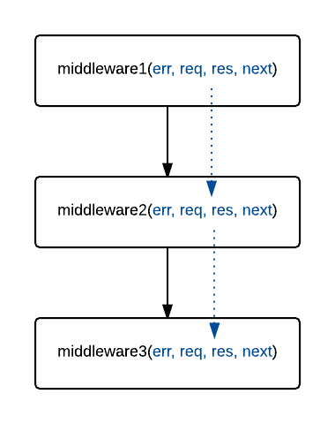
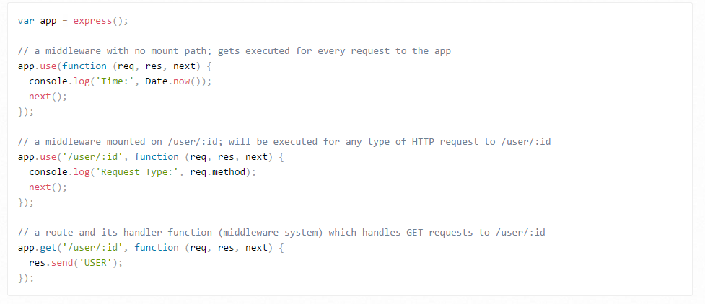
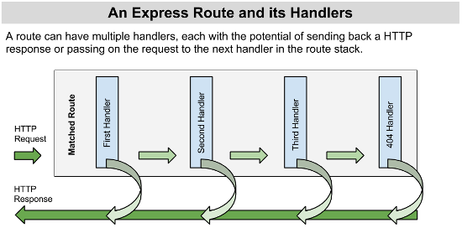
Node Express Express Example
Call local or cloud infrastructure APIs

Slide 5
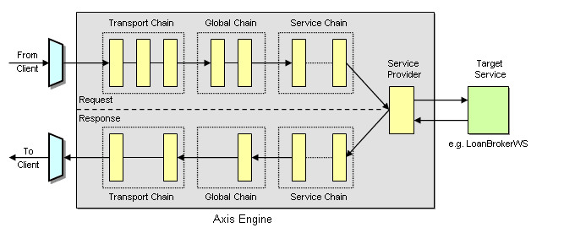
Apache Axis Example
The before and after handlers/middleware interceptors
May perform inline processing of request, e.g. validate signature and/or
May call an external service API, e.g. logging, check an ETag in a ledger, etc.

Slide 6
Project

